Slide 1
Chapter 1: What is Blockchain?
Learning Bluemix & Blockchain
Bob Dill, IBM Distinguished Engineer, CTO Global Technical Sales
David Smits, Senior Certified Architect, IBM Blockchain

Slide 2
The Plan: 30 minute Chapters with an hour or two of practice
Chapter 1: What is Blockchain? Concept and Architecture overview
Chapter 2: What's the story we’re going to build
Chapter 2.1: Architecture for the Story
Chapter 3: Set up local HyperLedger V1 development environment
Chapter 4: Build and test the network
Chapter 5: Administration User Experience
Chapter 6: Buyer Support and User Experience
Chapter 7: Seller Support and User Experience
Chapter 8: Shipper Support and User Experience
Chapter 9: Provider Support and User Experience
Chapter 10: Finance Company Support and User Experience
Chapter 11: Combining for Demonstration
Chapter 12: Events and Automating for Demonstration

Slide 3
Zero To Blockchain
Online, free tutorial on getting started with Blockchain and IBM Bluemix
The tutorial will build a blockchain solution on IBM Bluemix using
HyperLedger Composer V 0.10 or higher.
Hyperledger Fabric V1.0 or higher
Go, NodeJS, Angular
HTML, CSS, Javascript
All code for the tutorial is in github:
https://github.com/rddill-IBM/ZeroToBlockchain
Basic introduction to coding for Bluemix, getting an id, setting up your workstation can be found in the popular ZeroToCognitive series:
https://www.youtube.com/playlist?list=PLnJzIOiv6cVTaS8k90R3T9AlS_kf5XWmX

Slide 4
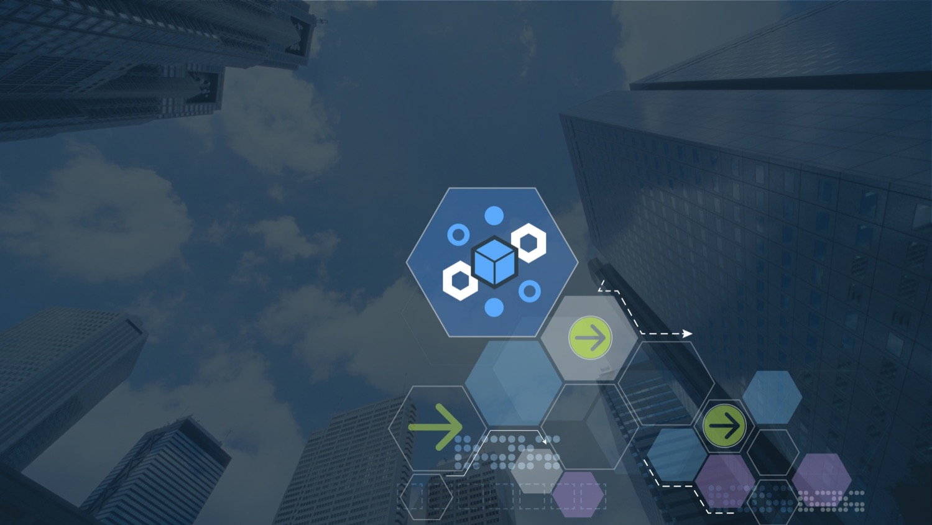







Blockchain education series
Explained
Solutions
Composed
Architected
Explored
Next Steps
Blockchain
Explained
V4.06, 28 July 2017
© 2017 IBM Corporation
Notes:
This is a high level introduction to blockchain concepts and business value. Presentations in this series are:
Blockchain Explained: High level introduction to blockchain for business
Blockchain Solutions: Use-cases, references and how IBM can help
Blockchain Composed: A technical introduction to Hyperledger Composer
Blockchain Architected: A technical introduction to the concepts and components of a blockchain solution
Blockchain Explored: A technical deep dive on Hyperledger Fabric
Blockchain Next Steps: How to proceed on a first project
There is much hype around Blockchain. Most of this relates to the use of Blockchain to underpin the Bitcoin cryptocurrency. Whilst IBM are not interested in cryptocurrency, we are very interested in exploring the broader business application of blockchain technology. This is a transformational opportunity for many of our clients.
IBM is a recognized leader in making blockchain real for business. We are helping many hundreds of clients on their blockchain journeys.
This presentation is the first step! IBM has lots of educational material (signified by the breadcrumb trail at the top of this chart) and a well-defined engagement process that will help. We will take you through all of this later on in this presentation.
The latest copy of this presentation can be found on the IBM intranet at https://ibm.box.com/v/BlockchainExplained. Feel free to distribute a PDF of this file to clients.

Slide 5


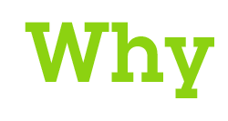

Contents
is Blockchain?
is it relevant for our business?
4
Notes:
Presentation is in three sections addressing the “big” questions for business use of Blockchain.
First section we will give CONTEXT for Blockchain by looking at the BUSINESS NETWORK and how to make this relevant for the 21st Century.
Then consider benefits and use cases for industrial Blockchain.
Finally focus on practical steps to make this new technology real for business.

Slide 6

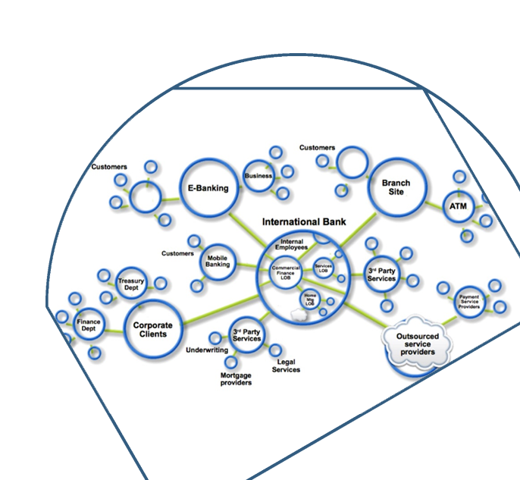

Business networks, wealth & markets
Business Networks benefit from connectivity
Participants are customers, suppliers, banks, partners
Cross geography & regulatory boundary
Wealth is generated by the flow of goods & services across business network in transactions and contracts
Markets are central to this process:
Public (fruit market, car auction), or
Private (supply chain financing, bonds)
Notes:
Business never operates in isolation. They are participants in a business network.
Business Networks will connect customers, suppliers, banks and regulators and will cross geographical boundaries.
WEALTH is generated as goods and services move across this network; this flow is referred to as a MARKET.
Growth of wealth can be constrained if the network is heavily silo’d or inefficient.

Slide 7
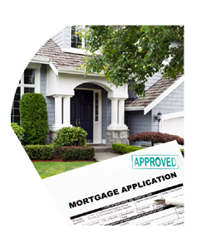
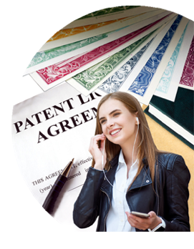
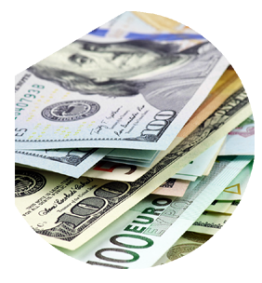
Transferring assets, building value
Anything that is capable of being owned or controlled to produce value, is an asset
Two fundamental types of asset | Intangible assets subdivide | Cash is also an asset
Tangible, e.g. a house Intangible, e.g. a mortgage | Financial, e.g. bond Intellectual, e.g. patents Digital, e.g. music | Has property of anonymity
Notes:
Ownership of assets pass across the network in return for payments, and governed by contracts.
ASSETS can be tangible and intangible, We are most comfortable with tangible (Cars, Houses),
INTANGIBLE assets – financial instruments most obvious, but don’t forget about intellectual assets like patents and growing digital assets (music, games, video, art).

Slide 8
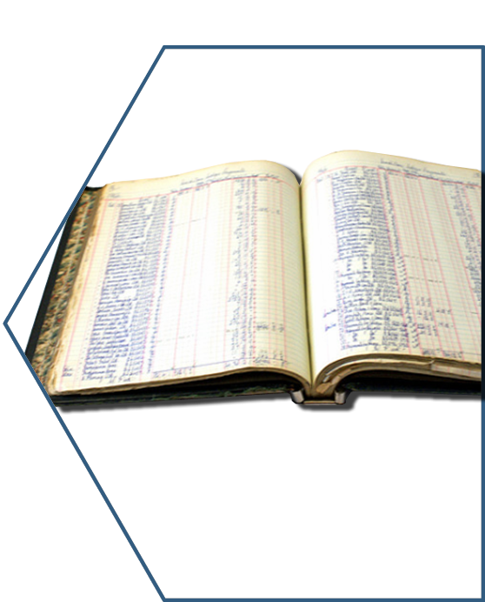
Ledgers are key …
Ledger is THE system of record for a business.
Business will have multiple ledgers for multiple business networks in which they participate.
Transaction – an asset transfer onto or off the ledger
John gives a car to Anthony (simple)
Contract – conditions for transaction to occur
If Anthony pays John money, then car passes from John to Anthony (simple)
If car won't start, funds do not pass to John (as decided by third party arbitrator) (more complex)
Notes:
Ledgers are not new – they have been used for double entry book keeping since the 1494 when Luca Pacioli (the Franciscan monk) created double-entry book-keeping.
Commercial usage of the term is for the "principal book of account" in a business house.
THE system of record for recording asset transfer in and out of a business.

Slide 9
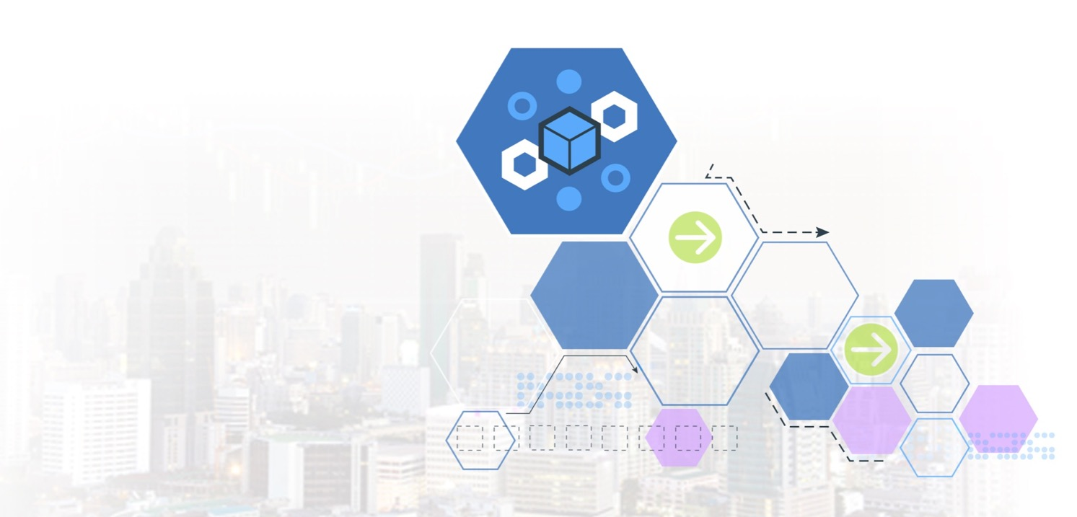
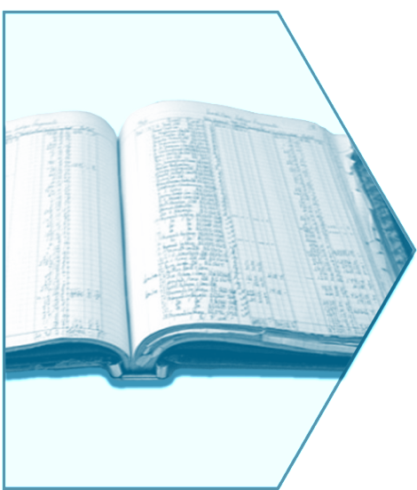
Introducing Blockchain
with shared business processes
A trusted, distributed ledger
Notes:
What’s new here is the SHARED LEDGER – up to this point each participant had their own Ledger
This sharing is the foundation for innovative business solutions,
This introduces an interesting set of technical challenges, including (1) participant identity and privacy & (2) transaction privacy
Let’s look at this in some more detail.

Slide 10
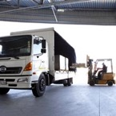
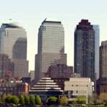
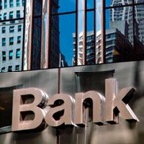




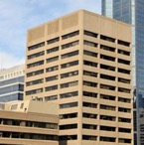
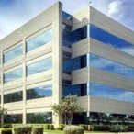
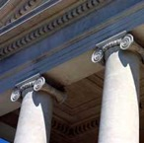


Problem …
Participant B’s records
Participant A’s records
Bank records
Insurer records
Regulator records
Auditor records
… inefficient, expensive, vulnerable
Notes:
This is the “BEFORE” picture representing the “status quo” for business networks.
Each participant keeps their own ledger(s) which are updated to represent business transactions as they occur.
This is EXPENSIVE due to duplication of effort and intermediaries adding margin for services.
It is clearly INEFFICIENT, as the business conditions – the contract – is duplicated by every network participant
It is also VULNERABLE because if a central system (e.g. Bank) is compromised due to an incidents this affects the whole business network. Incidents can include fraud, cyber attack or a simple mistake.

Slide 11


A shared replicated, permissioned ledger…
Participant B’s records
Participant A’s records
Bank records
Blockchain
Insurer records
Regulator records
Auditor records
… with consensus, provenance, immutability and finality
Notes:
The novel Blockchain architecture give participants the ability to share a ledger which is updated every time a transaction occurs through peer to peer replication.
Cryptography is used to ensure that network participants see only the parts of the ledger that are relevant to them, and that transactions are secure, authenticated and verifiable.
Blockchain also allows the contract for asset transfer to be embedded in the transaction database determining the conditions under which the transaction can occur.
Network participants agree how transactions are verified through consensus or similar mechanisms. Government oversight, compliance & audit can be part of the same network.
Participants SAME AS BEFORE – this is not a disintermediation play
CONSENSUS– means all participants agree that a transaction is valid
PROVENANCE– means participants know where the asset came from and how it’s ownership has changed over time
IMMUTABILITY– means no participant can tamper with a transaction once it’s agreed. If a transaction was in error then a NEW transaction must be used to reverse the error, with both visible
FINALITY– means that there is ONE place to determine the ownership of an asset or completion of a transaction. This is the role of the SHARED LEDGER.

Slide 12


Blockchain underpins Bitcoin …
is:
An unregulated shadow-currency
The first blockchain application
Resource intensive
Blockchain for business differs in key areas:
Identity over anonymity
Selective endorsement over proof of work
Assets over cryptocurrency
Page
11
Notes:
Blockchain technology enables the Bitcoin crypto currency and is best known for this usage.
However, the shared ledger technology is separate & separable – applicable to a whole range of business challenges that cross all industries.
IBM is not interested in crypto currency, but is missioned to help our customers make the most from Blockchain technologies. We see this as a major transformation opportunity for many of our customers.
Digital currencies (i.e. the representation of FIAT currency as an asset on a blockchain) are auditable and permissioned, hence excellent Blockchain use case
Excellent document from IMF on different (digital) currencies [can be used to close down discussions] > https://www.imf.org/external/pubs/ft/sdn/2016/sdn1603.pdf

Slide 13
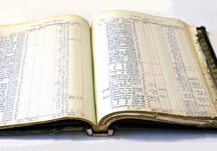
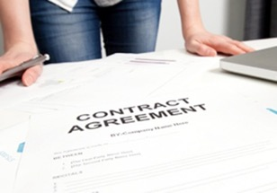


Requirements of blockchain for business
Shared ledger
Smart
contract
Append-only distributed system of record shared across business network
Business terms embedded in transaction database & executed with transactions
Ensuring appropriate visibility; transactions are secure, authenticated & verifiable
Transactions are endorsed by relevant participants
Privacy
Trust
Notes:
So Blockchain technology comprises these four main blocks, that can lead to increased efficiencies, and cost reduction across the business network.
We will “unpack” CONSENSUS PRIVACY & SMART CONTRACT in the next couple of slides.
Shared LEDGER has been already covered, and a SMART CONTRACT enables the business rules implied by the contract to be embedded in the Blockchain and executed with the transaction
After giving this chart:
If you are pushed for time you might want to skip the next four charts, which go into the detail of this one.
For a less technical audience, you might want to skip straight to a demo (e.g. car leasing).

Slide 14
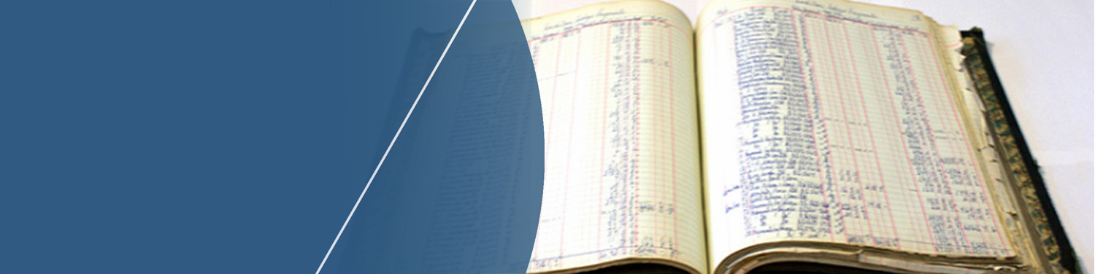
Shared ledger
Records all transactions across business network
Shared between participants
Participants have own copy through replication
Permissioned, so participants see only appropriate transactions
THE shared system of record
Notes:
The ledger is the first “thing” that constitutes blockchain. The is an append-only system of record that has appropriate privacy and permissions.
It is a modernisation of the ledger concept that has been around for ages. Crucially the ledger is now shared among the participants of the business network.

Slide 15

Smart contract
Business rules implied by the contract … embedded in the Blockchain and executed with the transaction
Verifiable, signed
Encoded in programming language
Example:
Defines contractual conditions under which corporate Bond transfer occurs
Notes:
The smart contract is the second “thing” associated with blockchain and describes the rules that govern a transaction.
To a technical audience, a transaction is analogous to a stored procedure call on a database. The smart contract is simply a piece of code that runs; the input parameters to the code (and a reference to the code itself) are stored as the transaction details.
In Hyperledger Fabric the smart contract is implemented as “chain code”.

Slide 16

Privacy
The ledger is shared, but participants require privacy
Participants need:
Appropriate confidentiality between subsets of participants
Identity not linked to a transaction
Transactions need to be authenticated
Cryptography central to these processes
Notes:
Not every member of business network can see all of the Blockchain
Cryptography controls who can see what
Implies user registration process to build trust network and access permission via certification management

Slide 17

Trust
The ledger is a trusted source of information
Participants endorse transactions
Business network decides who will endorse transactions
Endorsed transactions are added to the ledger with appropriate confidentiality
Assets have a verifiable audit trail
Transactions cannot be modified, inserted or deleted
Achieved through consensus, provenance, immutability and finality
Notes:
CRYPTOGRAPHIC consensus needed to support participant anonymity – this is NO TRUST system
This is expensive, giving a COST to anonymity.
When there is TRUST in a business network this become less, in the limit superfluous
So as TRUST increases then cost of consensus decreases or in the limit can be eliminated

Slide 18

Contents
is Blockchain?
is it relevant for our business?
Notes:
Pause for questions.

Slide 19

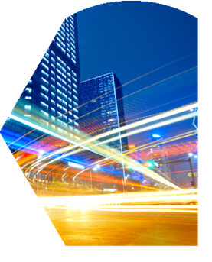

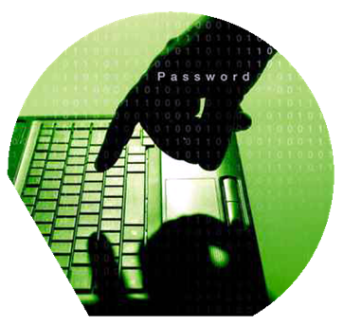
Blockchain benefits
Saves time | Removes cost | Reduces risk | Increases trust
Transaction time from days to near instantaneous | Overheads and cost intermediaries | Tampering, fraud & cyber crime | Through shared processes and recordkeeping
Notes:
Other benefits include :
Improve discoverability - When everyone on an exchange can view the same ledger, it is easy to broadcast an intention (or offer) by appending it. For example, in a trading network, all asks and bids would be visible to every network participant.
Automate trusted processes - Unlike a centralized system where only the network operator can create a generalized solution that fits every user’s needs, Blockchain networks allow each participant to create customized solutions using their own proprietary business logic while running on the same common ledger.
Ensure trusted record-keeping - By design, no one party can modify, delete, or even append any record to the ledger without the consensus from others on the network, making the system useful for ensuring the immutability of contracts and other legal documents.

Slide 20

Example:
Shared reference data
Benefits
Consolidated, consistent dataset reduces errors Near real-time access to reference data Naturally supports code editing and routing code transfers between participants
What | Competitors/collaborators in a business network need to share reference data, e.g. bank routing codes Each member maintains their own codes, and forwards changes to a central authority for collection and distribution An information subset can be owned by organizations
How | Each participant maintains their own codes within a Blockchain network Blockchain creates single view of entire dataset
Notes:
Any reference data that is shared in a business network is a potential blockchain network.
Think bank routing codes or common vocabularies for asset exchange data, where it’s important to be able to make changes to the data set in real time (and without requiring a trusted third party).
Also claim or identity information as required for fraud prevention in insurance networks.

Slide 21

Example: Supply chain
Benefits
Trust increased, no authority "owns” provenance Improvement in system utilization Recalls "specific" rather than cross fleet
What | Provenance of each component part in complex system hard to track Manufacturer, production date, batch and even the manufacturing machine program
How | Blockchain holds complete provenance details of each component part Accessible by each manufacturer in the production process, the aircraft owners, maintainers and government regulators
Notes:
Supply chains are a great source of blockchain use-cases. Here are several examples:
Walmart – tracking the provenance of pork in China (reference example)
IBM Global Finance – reducing the cost of disputes with suppliers (reference example)
Everledger – storing the provenance of diamonds on a blockchain to prevent the trade in so-called blood diamonds (reference example)
Bringing together car servicing network with the manufacturer network would allow manufacturers to target car recalls more effectively
Storing the provenance of aircraft components on a blockchain to track servicing and replacement, and to prevent decommissioned components re-entering the supply chain

Slide 22

Example: Audit and compliance
Benefits
Lowers cost of audit and regulatory compliance Provides “seek and find” access to auditors and regulators Changes nature of compliance from passive to active
What | Financial data in a large organization dispersed throughout many divisions and geographies Audit and Compliance needs indelible record of all key transactions over reporting period
How | Blockchain collects transaction records from diverse set of financial systems Append-only and tamperproof qualities create high confidence financial audit trail Privacy features to ensure authorized user access
Notes:
A good first use-case, which is to give an organisation complete and consistent access to their own ledger.
Today organisations typically have audit and compliance departments that consolidate ledger information from different departments every so often in order to supply that information to the auditor or regulator. This is slow and the information quickly becomes out of date.
Blockchain allows this process to be automated and provides visibility to an organisation’s liquidity in real time.
Furthermore, bringing the auditor into this same business network would completely change the nature of audit and compliance, from being a push to the auditor to allowing the auditor to pull the information on demand.

Slide 23


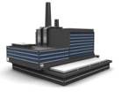

Letter of credit
Republic of A
B-land
Example: Letter of credit
Sales contract
Company A: Buyer/ applicant
Company B: Seller/beneficiary
Buyer applies for LC
Seller’s bank authenticates LC and credits Company B
Buyer’s bank issues LC and sends to seller’s bank
Bank A
Bank B
Benefits
Increase speed of execution (less than 1 day) Vastly reduced cost Reduced risk, e.g. currency fluctuations Value added services, e.g. incremental payment
What | Bank handling letters of credit (LOC) wants to offer them to a wider range of clients including startups Currently constrained by costs & the time to execute
How | Blockchain provides common ledger for letters of credit Allows all counter-parties to have the same validated record of transaction and fulfillment
Notes:
Letters of credit is a centuries old process (actually started in medieval times with the Knights Templar who required a way to allow pilgrims to travel to Jerusalem without the danger of carrying money around).
The letter of credit process is a difficult one to automate due to the sheer numbers of network participants involved. In this example we show Bank A and Bank B but in reality there is a complicated network in reality.
Blockchain gives us an opportunity to modernise; with blockchain, the letter of credit is stored on the blockchain and once spent, is marked as such so that the value of the letter cannot be spent again.
This use-case also allows for innovative methods of payment using Internet of Things (e.g. GPS, temperature sensors, humidity sensors). Smart contracts could implement rules that prevent/allow/increase/reduce payment if certain conditions hold (e.g. if it gets too hot/cold/humid/dry, or if the goods are a certain percentage of the way to the destination).

Slide 24
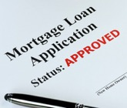



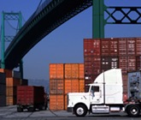
Potential use cases
Further examples by (selected) industry
Financial | Public Sector | Retail | Insurance | Manufacturing
Trade Finance Cross currency payments Mortgages | Asset Registration Citizen Identity Medical records Medicine supply chain | Supply chain Loyalty programs Information sharing (supplier – retailer) | Claims processing Risk provenance Asset usage history Claims file | Supply chain Product parts Maintenance tracking
Notes:
There are use-case examples everywhere, and we’re still in the early days of understanding the potential. Also be aware that many use-cases (e.g. supply chain) are cross industry.
For an active list of use cases by industry on the IBM intranet: http://ibm.biz/BlockUseCases

Slide 25
The Plan: 30 minute Chapters with an hour or two of practice
Chapter 1: What is Blockchain? Concept and Architecture overview
Chapter 2: What's the story we’re going to build
Chapter 2.1: Architecture for the Story
Chapter 3: Set up local HyperLedger V1 development environment
Chapter 4: Build and test the network
Chapter 5: Administration User Experience
Chapter 6: Buyer Support and User Experience
Chapter 7: Seller Support and User Experience
Chapter 8: Shipper Support and User Experience
Chapter 9: Provider Support and User Experience
Chapter 10: Finance Company Support and User Experience
Chapter 11: Combining for Demonstration
Chapter 12: Events and Automating for Demonstration

Slide 26
Chapter 2: The Story
Learning Bluemix & Blockchain
Bob Dill, IBM Distinguished Engineer, CTO Global Technical Sales
David Smits, Senior Certified Architect, IBM Blockchain

